Slide 1
A distributed mutual exclusion algorithm.
Suzuki, I. and Kasami, T. (1985) a distributed mutual exclusion algorithm. ACM Transactions on Computer Systems, vol. 3, No. 4 pp. 344-349.
Presented by Hugo Huipet.

Slide 2

MAIN PAPER CONTRIBUTION
Description of a mutual exclusion algorithm for a computer network faster than the Ricart and Agrawala algorithm.
http://www.eccitsolutions.com/services/computer-network-security-business-organizations-institutions/

Slide 3

PROBLEM
Network: N NODES
Shared Memory: NO
Communication: ONLY MESSAGES
Delay: UNPREDICTABLE
Arrival of Messages: NO ORDER GUARANTEED

Slide 4




RICART & AGRAWALA APPROACH
REPLY OK
REQUEST
NODE ID
REPLY OK
Sequence Number
…
REPLY OK
2 *(N-1) message exchange
REPLY OK
Requesting with MORE PRIORITY

Slide 5

NEW ALGORITHM (A)
NODE
RN
10
4
…
1
20
15
12
REQUEST (j,m)
NODE ID
Critical Region Inv #
…
PRIVILEGE (Q,LN)
LN
10
4
…
1
20
15
12
Q:

Slide 6
NEW ALGORITHM (A)
NODE 2
NODE 1
RN
1
0
…
0
0
0
0
REQ(2,0)
1
MAX{RN[2]=0,0+1}
To all nodes
REQ(2,0)
Node 1 FINISHED!
Send PRIV(TAIL Q, LN):
LN
0
0
…
0
0
0
0
PRIVILEGE
LN[1]= RN[1]
1
Q:
2
for all nodes:
RN[i] == LN[i] +1 && !in Q ?
END
Append

Slide 7
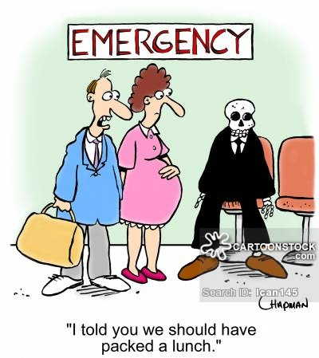
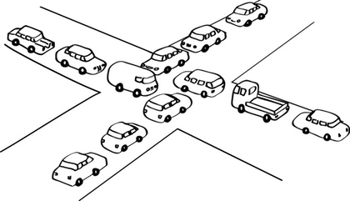
NEW ALGORITHM (A)
Starvation Free
DeadLock Free
N msg exchanges per mutex: N-1 REQ and 1 PRIV
Issues:
Unbounded
A node retains the privilege if none else is requesting

Slide 8
MODIFIED ALGORITHM (B)
How to bound sequence numbers?
With RN[i] + 1 mod L , L ≥2
But problem with delay in comms.
Solution:
REPLY OK
Received all K request messages of NODE j
NODE j
RN
10
4
…
1
20
15
REPLY OK
PRIVILEGE (Q,LN)
Q:
…
REPLY OK

Slide 9
MODIFIED ALGORITHM (B)
Average: N + (N-1)/L msg exchanges
FASTER and with fewer messages than R&A
But total number of information bits to be exchanged: LARGER

Slide 10
CRITIC
Can’t stablish a priority for nodes
Algorithm B is really Starvation FREE?
Both algorithms really deadlock free? (Node with privilege crashes)

Slide 11
THANKS

